Slide 1
Descriptive Statistics:
Part II

Slide 2
Shape
A third important property of data – after location and dispersion - is its shape.
Shape can be described by degree of asymmetry (i.e., skewness).
mean > median positive or right-skewness
mean = median symmetric or zero-skewness
mean < median negative or left-skewness
Positive skewness can arise when the mean is increased by some unusually high values.
Negative skewness can arise when the mean is decreased by some unusually low values.

Slide 3
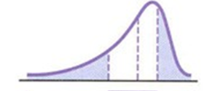
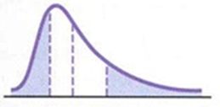
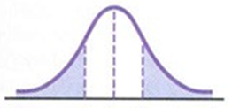
Skewness
Left skewed:
Right skewed:
Symmetric:
Source: Levine et al., Business Statistics, Pearson, 2013.

Slide 4
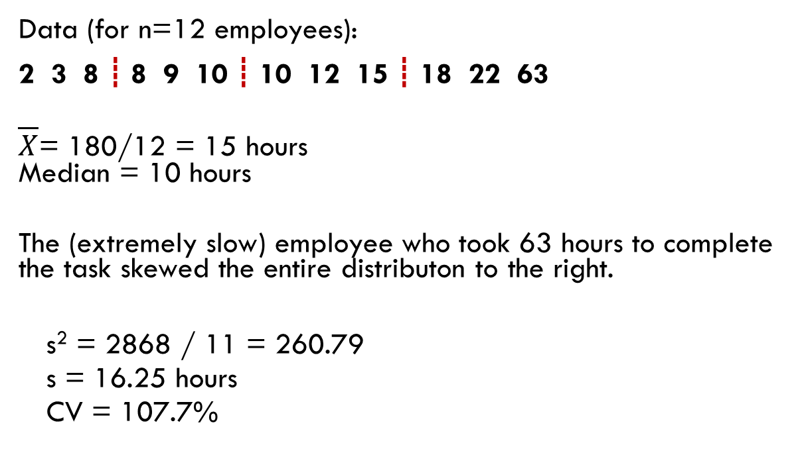
Example: # hours to complete a task
This guy took a VERY long time!
Data (for n=12 employees):
2 3 8 ┋ 8 9 10 ┋ 10 12 15 ┋ 18 22 63
$\overline{X}$= 180/12 = 15 hours Median = 10 hours
The (extremely slow) employee who took 63 hours to complete the task skewed the entire distributon to the right.
s² = 2868 / 11 = 260.79
s = 16.25 hours
CV = 107.7%

Slide 5
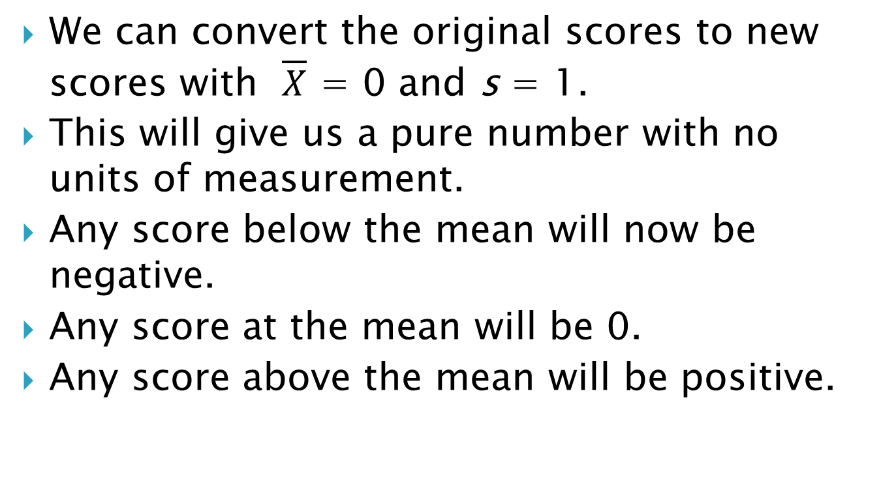
Standardizing Data: Z-Scores
We can convert the original scores to new scores with $\overline{X}$ = 0 and s = 1.
This will give us a pure number with no units of measurement.
Any score below the mean will now be negative.
Any score at the mean will be 0.
Any score above the mean will be positive.

Slide 6
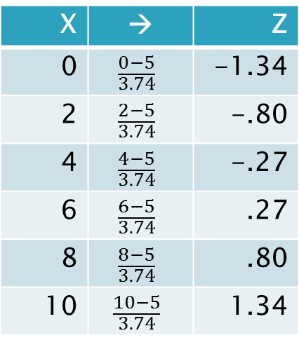

Standardizing Data: Z-Scores
To compute the Z-scores:
$$Z= \frac{X−\overline{X}}{s}$$
Example.
Data: 0, 2, 4, 6, 8, 10
$\overline{X}$ = 30/6 = 5; s = 3.74
X | → | Z
0 | $$\frac{0−5}{3.74}$$ | -1.34
2 | $$\frac{2−5}{3.74}$$ | -.80
4 | $$\frac{4−5}{3.74}$$ | -.27
6 | $$\frac{6−5}{3.74}$$ | .27
8 | $$\frac{8−5}{3.74}$$ | .80
10 | $$\frac{10−5}{3.74}$$ | 1.34

Slide 7
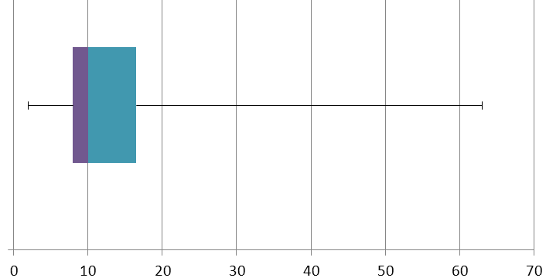
Boxplot
The boxplot is a way to graphically portray a distribution of data by means of its five-number summary.
Boxplot can be drawn along the horizontal or vertically.
Vertical line drawn within the box is the median
Vertical line at the left side of box is Q₁
Vertical line at the right side of box is Q₃
Line on left connects left side of box with X_{smallest} (lower 25% of data)
Line on right connects right side of box with X_{largest} (upper 25% of data)

Slide 8
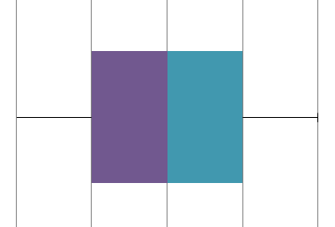
Boxplot
A “bell-shaped” symmetric data distribution would look like this:

Slide 9
Categorical Data
We summarize categorical data using frequencies and graphical methods.

Slide 10
Working with Frequencies
A frequency distribution records data grouped into classes and the number of observations that fell into each class.
A frequency distribution can be used for:
categorical data
numerical data that can be grouped into intervals
numerical data with repeated observations
A percentage distribution records the percent of the observations that fell into each class.

Slide 11
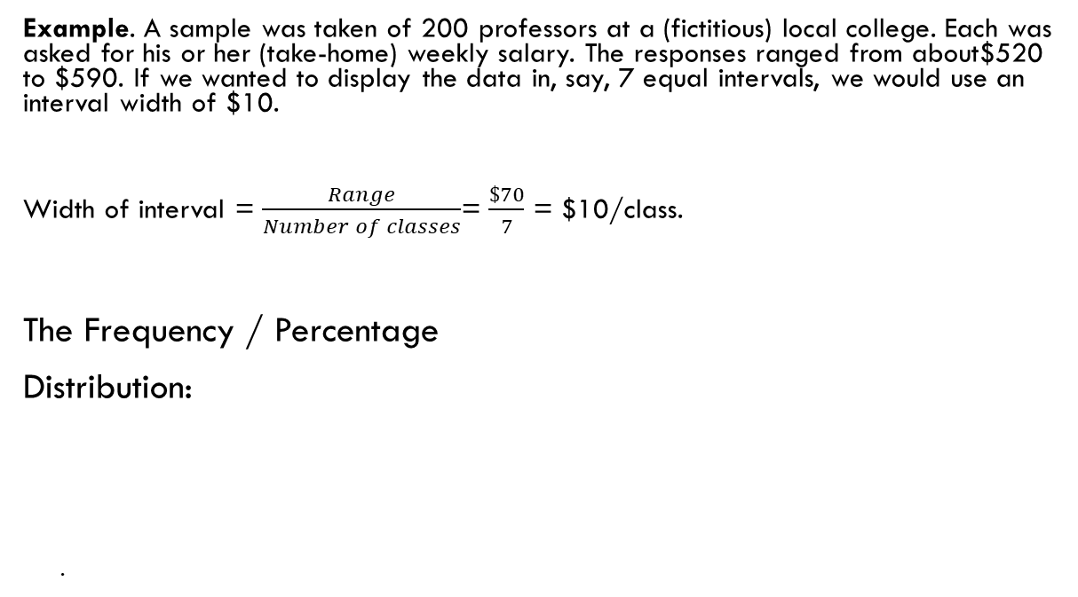
Working with Frequencies
Example. A sample was taken of 200 professors at a (fictitious) local college. Each was asked for his or her (take-home) weekly salary. The responses ranged from about$520 to $590. If we wanted to display the data in, say, 7 equal intervals, we would use an interval width of $10.
Width of interval = $\frac{Range}{Number of classes}$= $\frac{\$70}{7}$ = $10/class.
The Frequency / Percentage
Distribution:
.
Take-home pay |  | frequency | percentage
520 and under | 530 | 6 | 3 | %
530 " " | 540 | 30 | 15
540 " " | 550 | 38 | 19
550 " " | 560 | 52 | 26
560 " " | 570 | 42 | 21
570 " " | 580 | 24 | 12
To | 590 | 8 | 4
 |  | 200 | 100 | %

Slide 12
Working with Frequencies
A Cumulative Distribution focuses on the number or percentage of cases that lie below or above specified values rather than within intervals.
Take-home pay |  | frequency | percentage
less than | 520 | 0 | 0
" " | 530 | 6 | 3
" " | 540 | 36 | 18
" " | 550 | 74 | 37
" " | 560 | 126 | 63
" " | 570 | 168 | 84
" " | 580 | 192 | 96
" " | 590 | 200 | 100

Slide 13
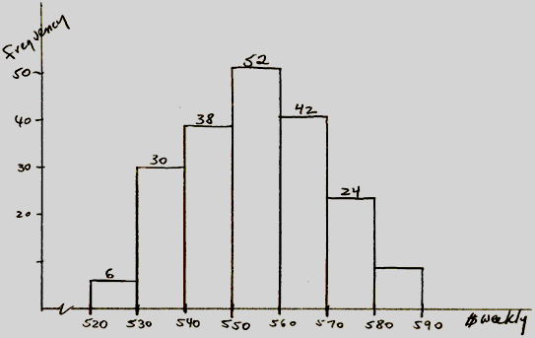
Working with Frequencies
The Frequency Histogram:

Slide 14
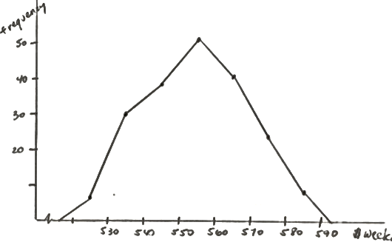
Working with Frequencies
The Frequency Polygon

Slide 15
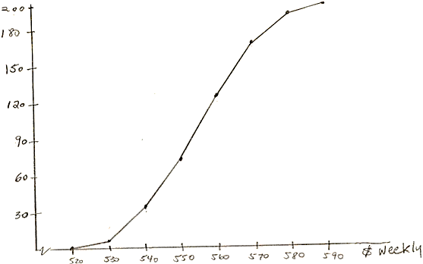
Working with Frequencies
The Cumulative Frequency Distribution

Slide 16
Descriptive Statistics – 2 variables
Categorical Data – graphical representation
Contingency Table
Side-by-Side Bar Chart
Numerical Data – looking for relationships in bivariate data
Scatter Plot
Correlation
The Regression Line

Slide 17
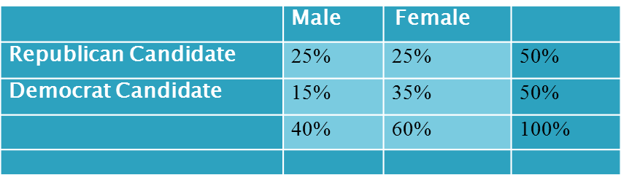
The Contingency Table
Two categorical variables are most easily displayed in a contingency table. This is a table of two-way frequencies.
Example: “Who would you vote for in the next election?”
This also works for two-way percentages:
.
 | Male | Female
Republican Candidate | 250 | 250 | 500
Democrat Candidate | 150 | 350 | 500
 | 400 | 600 | 1000

Slide 18
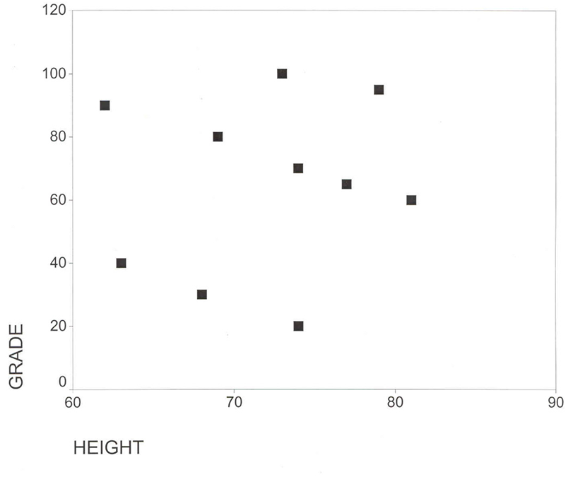
The Scatter Plot
What can we do with 2 numerical variables? We can graph them.
Example – Grade and Height (in inches)
Y (Grade) | 100 | 95 | 90 | 80 | 70 | 65 | 60 | 40 | 30 | 20
X (Height) | 73 | 79 | 62 | 69 | 74 | 77 | 81 | 63 | 68 | 74

